Slide 1


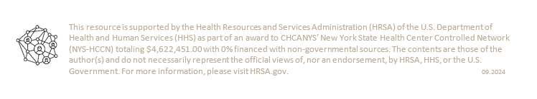
CHCANYS NYS-HCCN presents
Data Governance Excellence Series: Building a Strong Foundation
Session 3: Data Governance Program Maintenance & Strategies
October 29, 2024
For more information, please email Anita Li at ali@CHCANYS.org

Slide 2

Housekeeping
You have been muted upon entry. Please respect our presenters and stay on mute if you are not speaking.
Please share your questions in the chat. CHCANYS staff will raise your questions to our speakers and follow up as needed if there are unanswered questions.
The webinar is being recorded and will be shared after the session along with the slide deck.
A webinar evaluation will be shared with participants

Slide 3
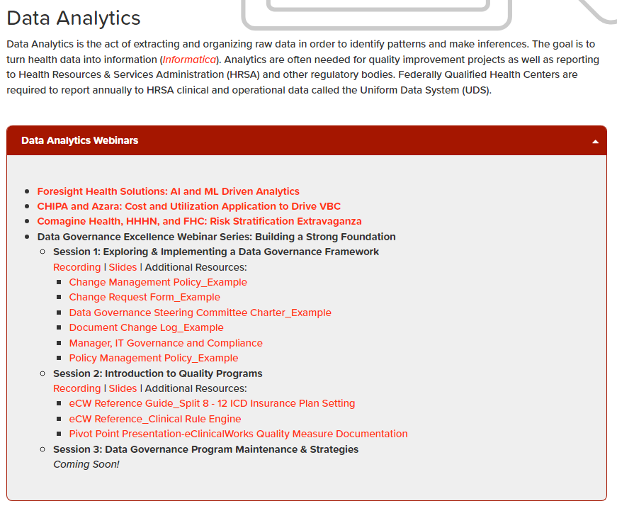
Recording & Resources
Chcanys.org > CHC Resources > Health IT > Data Analytics > Data Analytics Webinars

Slide 4
New York State HCCN Objectives
Project Period 2022-2025
2022-2025 Project Period
1
Clinical Quality
Patient Engagement
Patient Privacy & Cybersecurity
Social Risk Factor Intervention
Disaggregated Patient-level Data (UDS+)
2
Interoperable Data Exchange & Integration
Patient-Centered Care
Data Utilization
Leveraging Digital Health Tools
Health IT Usability & Adoption
Health Equity and REaL Data Collection*
Improving Digital Health Tools- Closed Loop Referrals*
3
Provider and Staff Wellbeing
* - Applicant Choice Objective
Bold- Objective Carried over into 2022-2025

Slide 5
Schedule of Events
Session 1 (10/1)
Session 2 (10/15)
Data Governance Program Maintenance & Strategies
Exploring & Implementing a Data Governance Framework
An Introduction to Quality Programs
Session 3 (10/29)

Slide 6

Meet the Presenter
Jackie Simik, B.S., CPC-A
MANAGER, EHR ENTERPRISE APPLICATIONS
Pivot Point Consulting

Slide 7



Data Governance Excellence Series: Part III
Data Governance Program Maintenance & Strategies
Notes:
Thank you for joining us today in the last of the 3-part series on Developing a Data Governance Framework
Today we will be talking about some of the ongoing items that come with maintaining a data governance program.
All participants will be placed on mute during the presentation. Please put any questions or comments in the chat so we can review them during the Q & A session. This meeting is being recorded and the slide deck will be sent out to participants at the conclusion of the session today.

Slide 8
Quality Programs Presenter
Bachelor of Science in Organizational Leadership, Pennsylvania State University
Certified in EpicCare Ambulatory & Epic PB Resolute
AAPC Certified Professional Coder
eClinicalWorks® Super User and Implementation Specialist, 15 years
Multi-faceted experience spanning over 30 years in the healthcare industry:
  Operations and administration
    Outpatient clinics
    Physician clinics
    Hospital ancillary services
  Revenue Cycle Management
  Clinical Quality Program Initiatives
  Human Resources & Employee Relations
  Regulatory & Compliance
  EHR Implementation and Optimization
  Project Management
Jackie Simik, B.S., CPC-A
Healthcare EHR/Advisory Manager
Pivot Point Consulting, A Vaco Company
https://www.linkedin.com/in/jacquelinesimik/
Notes:
My name is Jackie Simik and I’m a healthcare IT consultant. I have worked in the healthcare industry for over 30 years in various aspects such as Billing and Revenue Cycle Management, Oncology, Radiology, Outpatient Clinic Administration and Management, Private Practice Administration, and most recently I worked with a clinically integrated network in the Chicagoland area before coming to Pivot Point for consulting. I have a wide-ranging background that includes billing and coding, as well as regulatory compliance and data reporting.
I have been with Pivot Point for over 2 years working with eClinicalWorks customers to optimize how they utilize the various tools in their EHR to not only streamline workflows but also to help with data collection efforts. I also have 2 Epic certifications and am currently working on my Project Management Professional Certification.
Thank you for having me back today to conclude our data governance program journey.

Slide 9
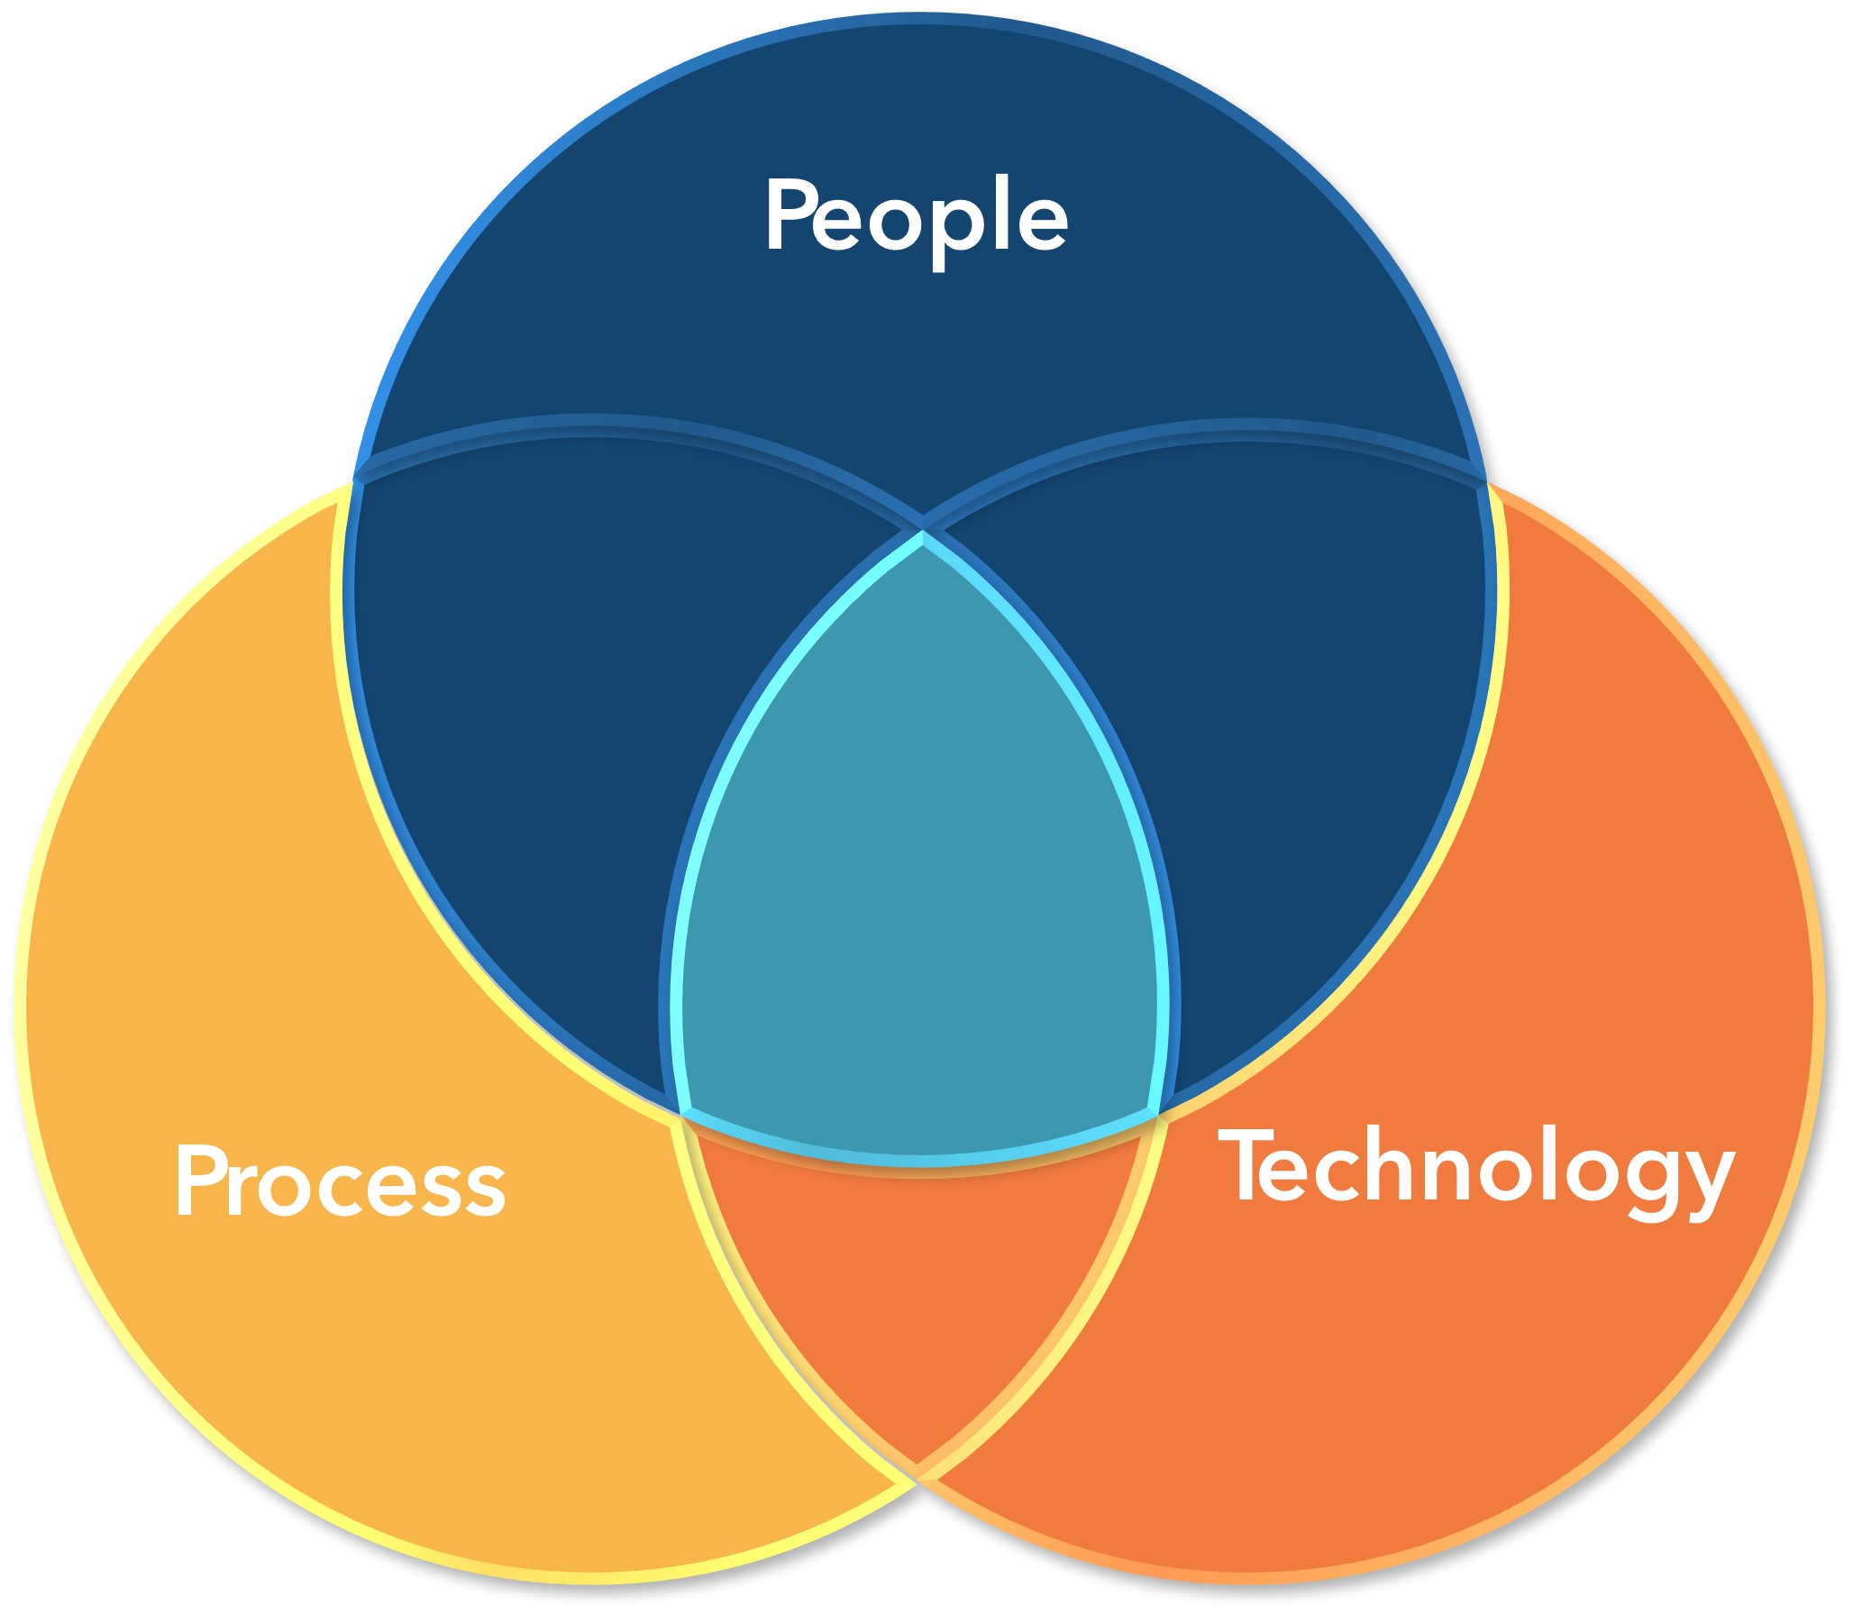
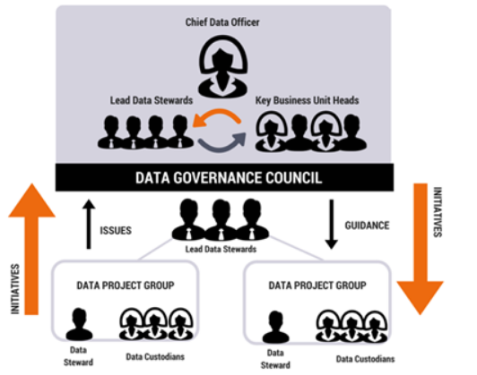
Quality Programs The Framework
Governance
Security & Accessibility
Security & Accessibility
Data Quality & Management
Notes:
In our last two sessions we discussed how People Process and Technology all play a role in the data governance program and overall framework. These components cannot exist alone but comingle at any time at every level, that’s our light blue zone on the diagram. It is in this synergist area that all the moving parts come together to create the framework.
The Data Governance Program for your organization should explain how the program operates, who makes decisions, what are the processes that are to be followed, how is change management handled, how are policies and procedures reviewed and approved? It contains the standards and guidelines for how the program is run. It governs the work.
It is the steering committee that will be doing and/or directing the work. There can be many steering committees that fall under your data governance program, such as one specific to Information Technology for software and hardware procurement and integration, Clinical teams to create standardized clinical pathways, as well as a Quality Steering Committee as we have been discussing here. The governance program provides the necessary framework on how each of the steering committees will conduct themselves with standard processes and procedures to follow. The important piece is that while there may be different committees under the program, at some point all those committees should be communicating and collaborating at some level to ensure that one hand knows what the other is doing and how their work may be affecting the other teams.
The Governance Council is typically made up of leaders of the various steering committees and is responsible for communicating and explaining organizational strategies and/or goals throughout the organization. Each steering committee puts forth initiatives for work towards those goals in their respective areas. Those steering committees then create project teams, who then determine what needs to be done, which can include new build, training, workflow changes, and perhaps a bit of all three. Issues that arise with the carrying out of the initiatives will go back through to the Steering Committee via project updates or the change management process to receive further guidance on next steps. It is a constant collaboration and communicative process, which, when done correctly will engage stakeholders at all levels. Communication, collaboration, and transparency are key to a successful program
In our last session, we reviewed some of the most popular quality programs and what to look for in terms of the measure definitions, how patients are attributed to providers and how the patient may fall into a category for data collection. The nuances to the similar measures across programs were also discussed and the importance to compare measure criteria of measures that at first may appear to be the same across different quality programs. It is in these differences that achieving a measure can make or break you.
Today, we will be looking at ways to sustain the model we have been discussing and provide some insights on how to continue to build on the framework to make your program truly a representation of your organization’s mission, vision, and values to achieve your strategic goals.

Slide 10
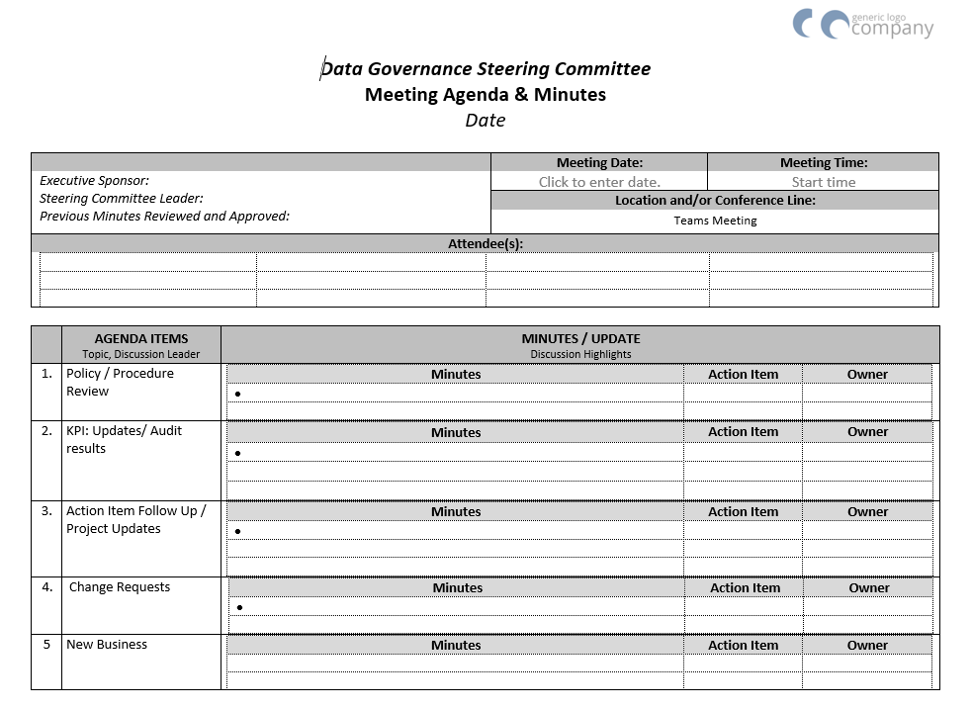
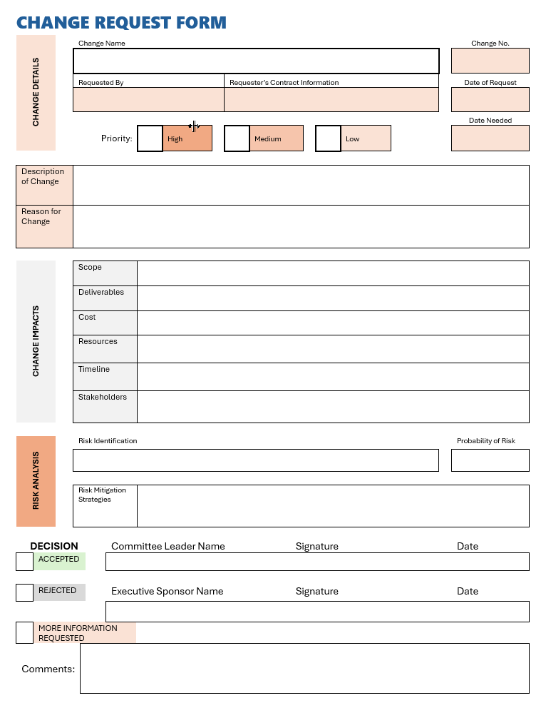
Quality Program Responsibilities
Steering Committee Meetings
Scheduled
Duration
Collaborative
Documented
Agendas
Distributed prior to meeting
Consistent, standardized
  Policy & Procedure Review
  Key Performance Indicators
  Audit Results
  Change Management
  New Business
Training & Education
Communication
Incorporation
Notes:
Having a data governance program is a great way to promote interdisciplinary collaboration as well as to keep a pulse on the organization to ensure that the strategic goals are being met, moving the organization forward.
To do that, certain activities need to be hardwired into the organization, such as maintaining stakeholder engagement, regular steering committee meetings, regular policy review to ensure that policies and procedures are relevant and continue to outline the practices of the organization and remain aligned to the strategic goals, mission, vision, and values of the organization.
By carefully selecting relevant key performance indicators, monitoring, auditing and reporting them on a regular basis and keeping stakeholders engaged and motivated promotes an organizational sense of team where everyone is contributing and working towards the same goals. Easier said than done, right?
It can be, but it takes effort and consistency.
Having regularly scheduled meetings is helpful and putting them on the Steering Committee member’s calendars ahead of time, possibly as a recurring meeting for at least 6 months to a year out, will block their calendars to increase the attendance rate. The frequency and length of the meetings will need to be determined, or if this is something new, maybe meet more frequently until the program is up and running, then when the time is right, discuss the timing of meetings, which will be based on the work that is being done. With change management being an ongoing issue that never ends, I would not recommend that these meetings are held any less than once a month as changes happen often and will need a regular review of change requests. There should be a designated minute taker to document the discussions and decisions of the steering committee. Once the steering committee is well-established look to using collaboration tools, such as Teams, to share, review, and approve change requests or other items the steering committee is working on. This can enable work to be done more quickly rather than waiting for a meeting to discuss an idea or topic. Change requests may even be able to be entered, discussed, and decided on much more quickly and with just as much collaboration.
Agendas are a key to the meetings and should be distributed to the Steering Committee prior to the meeting, along with the minutes from the last meeting, so all members can come prepared and ready to discuss the topics at hand. That should be the expectation. For items that require more discussion, create subcommittees that can meet separately then come back to the main group with recommendations on how to move forward. These subcommittees should have a deadline for their recommendations so the issues are resolved in a timely manner.
Policies are another item that should be on every agenda. With so many policies and procedures in one organization, it is impossible to think that they can all be reviewed at once each year. Create a review schedule for the policies of the organization. Make this a standing agenda item to review policies at each meeting. Ideally, these will be distributed, or a link shared to them, prior to the meeting so this can be done rather quickly. You don’t want everyone reading the policy IN the meeting, but rather come with it already reviewed and discuss any issues, updates, or comments. Any edits or changes should be made and don’t forget about any training materials or end user items that may need to be addressed. Policies cannot be changed and without communicated to the larger team. Make sure that a communication and training plan for the changes to any policies are made to inform all members of the organization. Be sure to also keep track of the changes made to the policy with dates for historical reference and perhaps the reason why the changes were made. This is as simple as keeping a document change log as the last page of each policy.
Key Performance Indicators, KPIs, should be reviewed by the team at every meeting and under performing measures should be discussed and remediation plans set into motion. Collaboration and inclusion of stakeholders is a crucial part of this agenda item. The focus should be on the process not the people, and root cause analysis can be done to determine why the measure is falling short.
In addition to reviewing results of the KPIs, audit results for the KPIs should be reviewed, as monitoring is important. There should be a process in place as to when a KPI has been hardwired and is no longer in need of regular monitoring. This is not to say that no monitoring will take place, but once a KPI has been met for a certain amount of time and the team has it hardwired and there is confidence in them, then they can move to a less frequent auditing schedule, and the team can select a new KPI to monitor and improve upon.
Change requests should also be reviewed at each meeting and a decision on the requests should be made. Communication regarding the change should be provided back to the requestor as well as the reasoning for the decision, especially if the change was denied. For approved requests, a plan to execute them along with communication to the team and training materials should be made along with a date the change will be made and live.
Training and education are a key to this Committee. The items that are reviewed, discussed, and decided on in this meeting will affect all the team members throughout the organization. Communication and education to the larger team should be a hardwired process. Not only does this gain the trust of the larger team, but also provides transparency into the process of decision-making helping the team to see the progression towards the strategic mission and goals. It can also help the larger team see the big picture and a clearer path of where the organization is headed and how what they do plays a part along that path.
The meeting agenda and discussion should have a main theme of strategic alignment and focus on what is relevant, regulated, and required to meet the objectives of the organization.

Slide 11
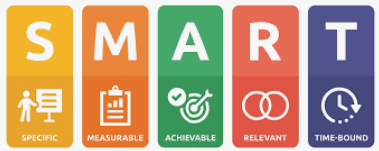
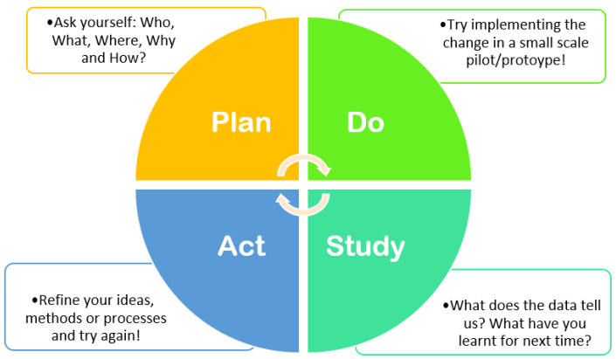
Quality Program Quality Management
Quality Management
Data Validation
Methodology
PI / Quality Plan
  Goal Setting
  Monitoring
  Revising
  Educating
Notes:
Quality management is an important piece of the Data Governance program.
There needs to be confidence in the data being reported.
To do this, data cleanliness is a must. What this means is that there needs to be a validation process to ensure data is not duplicated, formatted incorrectly, and is consistent from report to report. As we know, changes are made quickly to software systems, sometimes with or without our control, depending on the vendor and someone needs to be looking over what those changes are and how it may affect data collection efforts. This may mean, mapping structured data fields in the software, or updating a free text field to a structured field for data reporting, or creating new fields all together. It is important that someone in the organization is looking at these items on a continuous basis, monitoring updates and upgrades, doing testing, and validation checks. After all , the data that is being used is driving organizational decision-making, so it needs to be accurate and consistent. Those using the data, need to feel confident in its accuracy.
Defining how the data is collected is another task for the Data Governance program. Not only does the program select which key performance indicators are important to the organizational goals, but it needs to define who is documenting the data, what workflows are needed, where the documentation is located, how it is structured or mapped to be extracted to a report, and when the reporting needs to happen. This process makes up the Process Improvement Plan or Quality Plan. It is the who, what, why, how, and when. This is the document that will be reviewed at each Steering Committee meeting and really the heart of the program. It must be maintained regularly and used as a tracker to show where the organization is on track with goals or where they have opportunities to further improve. This is a living, breathing document of the organization and is ever-changing.
Goals for the Process Improvement plan should be Specific, Measurable, Achievable, Relevant, and Time-Bound.
Be Specific in what your goal is so it; when people know precisely what is needed, and is communicated effectively, they are more likely going to understand the purpose behind it
Determine a way to Measure the progress to the goal; this is the most difficult piece as some goals can be difficult to find ways to measure; be creative but be consistent
Make sure that the targets created are actually achievable; don’t make the targets so high that it is impossible. Perhaps creating milestone achievements are more helpful for the goal. It can be difficult to create buy-in around a goal when it seems insurmountable, by creating smaller increments of achievement targets, people will be able to see progress which may help increase momentum and buy in: Celebrate those wins!
Keep the goal relevant to the current climate or conditions of the organization and/or industry. It will be difficult to get buy-in and engagement from stakeholders if no one feels like the goal will make a difference or have an impact. Basically, work on things that need improvement. Don’t collect data just to collect data.
And then Time-Bound, make sure that there is a time frame attached to the goal. This can even be done by creating milestones or dates that certain achievement should be obtained and/or tied into the Achievable aspect.
Using the PDSA, Plan, Do, Study, Act methodology for managing and documenting the goals is a great way to continually monitor and make necessary changes towards meeting the goal. The documentation tells the story of the goal, how it came about, what is it trying to fix, where is it now and where it needs to be. All of the PDSA documents are what really makes up the Process Improvement Plan. Whatever methodology your organization chooses to use, make sure that everyone knows what that is and how to use it to make collaboration more effective across teams.

Slide 12
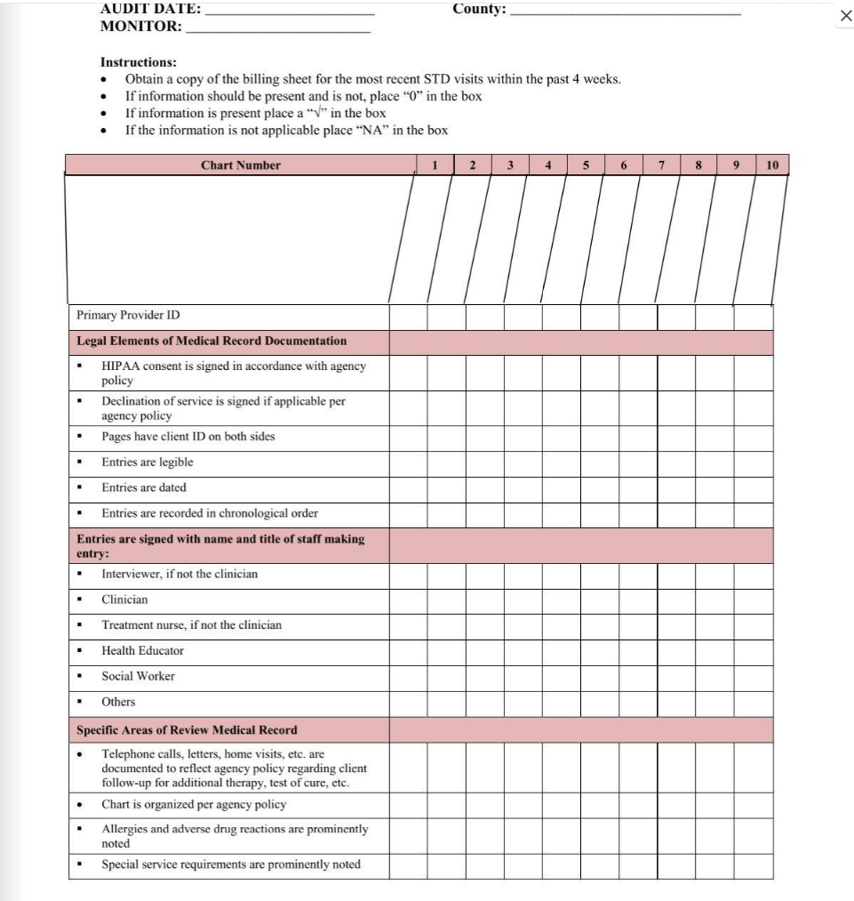
Quality Program Audits
Audits
What
When
Who
How
Reporting
Remediation
Don’t forget about regulatory agencies
What do you need to show compliance?
What patient data is required?
Are there targets to achieve?
Notes:
Audits. What a scary word, but this auditing isn’t scary at all. This type of auditing will provide results on where the organization is with meeting the goals of the plan in place and provide a clearer picture of how to move forward and what areas need the most focus. Keep in mind any regulatory requirements in which data needs to be submitted for. These should be at the top of your Process Improvement plan and monitored a bit more, especially if there is concern about being able to meet an identified goal.
Once the Process Improvement plan is in place, each of the goals of that plan should have an auditing plan. The first thing for each of the goals is to see where the baseline is. How are we performing now? Where do we stand? A pre-audit may need to be done to determine the current state, or maybe it was already done which is why it is on the PI Plan. Either way, this will establish a baseline for which future results can be compared against.
Next, you’ll need to determine when the audit should take place, prospectively or retrospectively, or both. This will depend on the type of measure or goal. Once that has been decided, the items that will be included in the audit need to be identified. What is needed to make sure you have the right data to show a status for meeting the goal.
When you have all those answers then you need a tool that will be used to perform the audit. Sometimes there is a standard tool for data collection, but some measures may need a tool created to capture the data in the preferred way. A sample size will need to be determined, criteria for sample selection will need to be documented along with the process by which the sample criteria is obtained. The format for data collection on the selected criteria needs to be determined along with how the audit results are to be reported out for review. Remember that PHI should be de-identified when reported out.
Creating the milestones, or progress measures, towards the goal also needs to be determined. Will you have one goal such as 90%, or will you have incremental goals such as 75%, 85%, 95%. This may be based on the quality program you participate in or internal goals. Either way, this needs to be determined, Typically this is done once a baseline is known so there is some insight into the level of effort that needs to be exerted towards achievement. Remember, it should be achievable. Sometimes baby steps have more of an impact where people can see movement, however small, but it can keep people motivated and promote buy in for the changes that they may need to be making in their day-to-day. And please don’t forget to celebrate the wins, however small. Progress is progress.
Reporting the results can be done via dashboards, graphs, and other means depending on the KPI. Reporting should go out consistently to monitor progress and be evaluated for any remediation or tweaks in the process. Sometimes this just means an education plan for staff or other times, it may involve more changes, but either way, monitoring it via audits and reviewing results often will certainly help move the needle in the right direction.

Slide 13
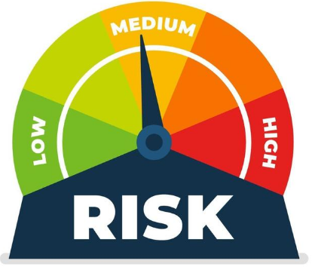
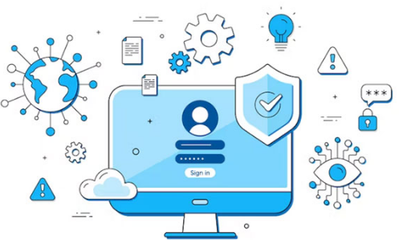

Quality Programs Security & Risk
Security & Risk
Cyber Security
Access & Use
Elements of Security & Risk Assessment
Asset Identification & Classification
Threat Identification
Vulnerability Assessment
Impact Analysis
Risk Scoring
Security Control Strategy
Compliance Assessment
Incident Response Plan / Disaster Recovery
https://www.netwrix.com/information_security_risk_assessment_checklist.html
7 Layers
Mission-Critical Assets
Data Security
Endpoint Security
Application Security
Network Security
Perimeter Security
The Human Layer
https://microage.ca/cybersecurity-layering-approach/
Security Access by Role/Responsibility
Vendor Access
Remote Access
PHI Disclosures / Reporting
Notes:
Security and Risk is a part of every data governance program, which is why it is important for IT to be represented on the Steering Committee. All perspectives need to be present to make sure that decisions are made with the complete organization in mind. When we are using data to drive our mission, we need to be sure that our data is safe and protected.
The Health Insurance Portability and Accountability Act, loving know as HIPAA, introduced the annual regulation of a Security & Risk Assessment for entities that collect and use Protected Health Information, or PHI. This is an honor system of sorts in which the Office of Civil Rights (OCR) assumes that all entities that are covered are performing this assessment annually. Some quality programs require proof that this is being done by their participants, or as in the MIPS program, a mere attestation stating it was done is enough. Don’t be fooled though, like all things, this can be audited by OCR and large penalties can be given for those not performing this assessment.
A security and risk assessment consists of 8 categories that encompass not only the electronic aspect of the organization, but the physical environment and devices used as well. Initially, when these are first performed the assessor will come on-site to each location. The purpose is to see how secure the location is, where information is kept and who has access. When all of the areas are assessed, a risk score is provided along with a report that lists out High, Medium, and Low risks. These risks are what make up the Remediation Plan, which is a living, breathing document of the organization detailing the current risks and how the organization is mitigating those risks with the goal of all risks being in the low category. It’s a stretch goal, however, the purpose of this document is to show that there is a focus on what the high risks are and how those are being managed and monitored to ensure the security of the data.
It’s also important to have disaster recovery plans in place should something happen. This piece is often overlooked and not much effort goes into this type of planning, but I can assure you, it can be very costly to an organization when something does happen, so it is imperative to have a plan in place to mitigate the negative consequences./
CyberSecurity contains 7-layers.
Mission critical assets consist of data that is absolutely critical to protect, such as EHR software. Measures need to be in place to guard against breaches and malicious attacks.
Data security refers to the transfer and storage of data. This includes how systems are backed up, where they are stored and for how long and how data is exchanged. Encryption is key to data security
Endpoint security includes the protection of mobile devices, desktops, and laptops and can be done via a network or a cloud-based system
Application security involves access control to applications and what the application can access within the organizational systems
Network security is crucial to ensure security controls are put in place to protect the network to prevent unauthorized access.
Perimeter security ensures that both physical and digital security methods protect the business as a whole. This includes firewalls that protect networks against external forces
The Human Layer is the weakest link in the security chain. This incorporates management controls and phishing simulations. Human management controls aim to protect that which is most critical to a business in terms of security, including the very real threat of cyber attackers and bad actors
Access & Use considers all things that access and use the systems and data contained in them
Security rights should be assigned to end users for what they need to perform their job. No more, no less. This can be difficult to manage with high turnover, however, knowing how your applications, specifically your EHR structures access will help to determine the best, most efficient way to manage this. Most EHRs have role-based security where a role such as Nurse is created and end users are assigned into that role rather than individually assigning one person at a time to each security right. In some applications, assigning an individual to several roles can create access issues so it is best to have roles that are able to be used for cross-trained end users.
Vendor access is also something that needs to be addressed. How do vendors get access? What access do they need? When do they need it? What authorization do they have? Can they access anytime? These are the items that need to be detailed out in your policy and procedure for vendor access.
With much of our world working remotely now, there needs to be a policy and procedure on who gets remote access and how their workstations are secured, located, and if they have the ability to print and how they dispose of printed materials when not in the office.
PHI Disclosures and reporting need to be addressed as well. How does your organization handle PHI Disclosures. This can be from how a patient or family member gains access to records all the way to a breach in the network exposing PHI and how that is reported to officials.
The organizational culture needs to be one that takes security seriously. You need to ensure that you and your staff are knowledgeable about the reality of cyberattacks and the importance of protecting data. The best way to approach security is to be proactive instead of reactive when threats or breaches take place.

Slide 14
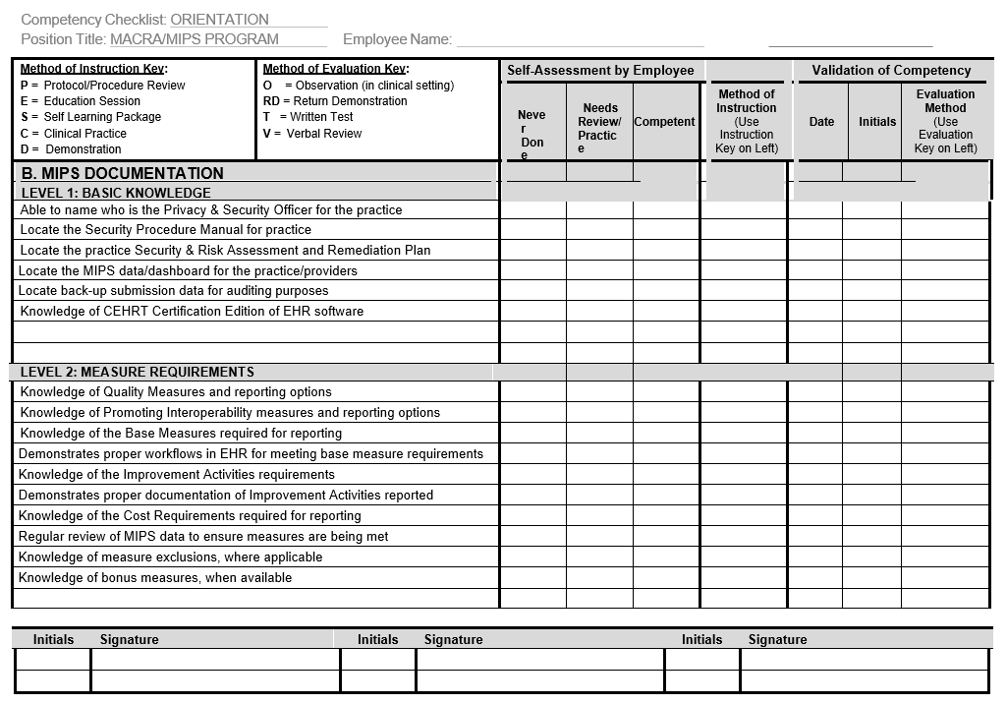
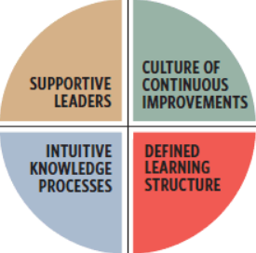
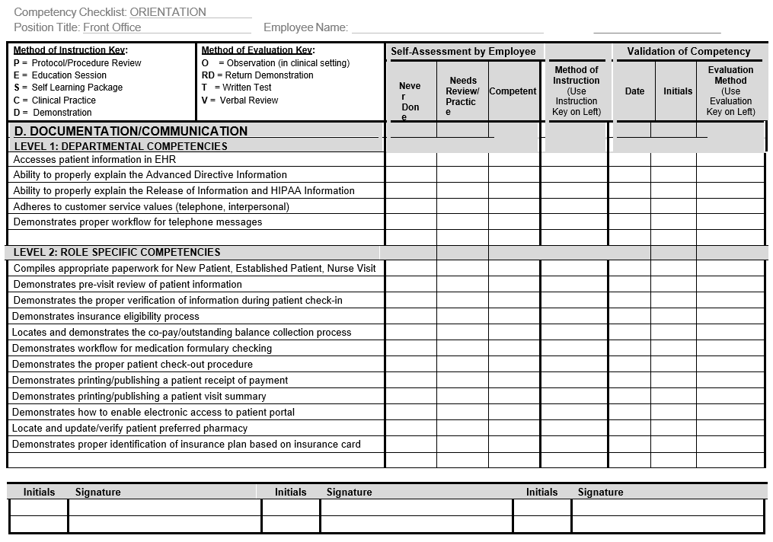
Quality Programs Training & Education
Competency
Knowledge Validation
90-days, Annually
Competencies by Role
Identify areas for improvement
Patient Safety
Stakeholder Engagement
Super Users
Train the Trainer Program
Mentorship Program
Succession Planning
Identify a backup resource
Train staff to be leaders
Transparency in the process
Continuous Education
Strategic Ongoing Education
Change Management Plan
Lunch & Learns
Process Improvement Initiatives
Credentials & Licensures
Notes:
As I mentioned earlier, Training and Education are a key to the Data Governance Program and always leads back to people, process, and technology at the center of it all.
People need to be trained, and their competency needs to be validated on the workflows so consistency in the data and standard workflows are upheld. As processes, or workflows, are revised, there needs to be a process in place to disseminate the information, train staff members, and validate their understanding of the new workflows or other updates. This can be done at the 90-day mark for new staff and annually for current staff. Having a documented competency will help with training and onboarding efforts. This is meant to be an engaging and interactive process where the team member does a self-assessment of their knowledge and then a super user, or leader or mentor, can work with the team member to demonstrate their knowledge and be deemed competent and also help identify training needs and develop training plans. Folding this into an annual review can not only help to validate to leadership that the processes are understood but also to be able to provide feedback to the staff member to allow for additional support or training if deemed necessary. Having ways to get team members motivated, such as selecting super users, assign a high performer to train new staff members, or even implement a mentorship program to make sure that the workflows, policies, and procedures are consistently held up to the same standard by the entire team. This goes back to data accuracy being important to documentation, collection, and overall reporting. Engaging stakeholders at all levels is also important as we look to the future, it is important to have a succession plan, as these will be the team members that may eventually hold positions on the Steering Committee as people leave the organization. Mentoring staff over time can be a very good way to continue the Data Governance Program into the future. Providing ways that front line staff can get involved whether it is gathering bits of data, training on a new workflow, or even updating documentation is a good way to begin to mine for the desired skill sets that are needed in the future. Identifying and growing people into a role is a great way to continue momentum and solidify the program moving forward.
Continuous Education is important, not only for clinicians to uphold their licensure or certifications statuses, but also to ensure that everyone remains engaged, and the goals are top of mind all the time. Hold regular meetings to share outcomes. Information is powerful and your team needs to know how what they do is incorporating into the success of the organization. Hold Monthly Lunch & Learns on various topics or areas of focus for the organization, or perhaps that is where a new workflow can be presented to the team along with the reasoning for the change or explanation of the goal that it is meeting. People are more likely to buy into change when they understand what is behind that change and how their work contributes to the organization. Communication fosters a culture of collaboration and trust as transparency is shown into the processes behind the change. This could also be a way to engage front line workers by allowing them to present information to the rest of the team on what they do and how their roles contribute to the success.

Slide 15
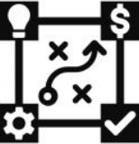
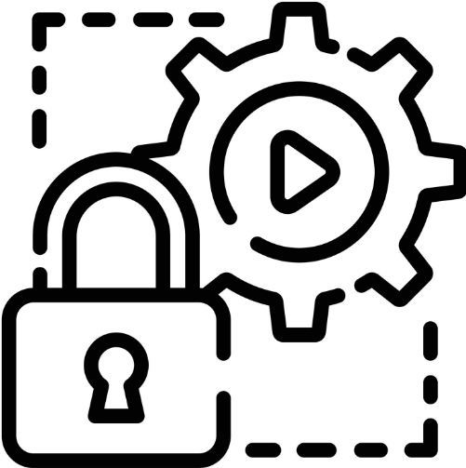

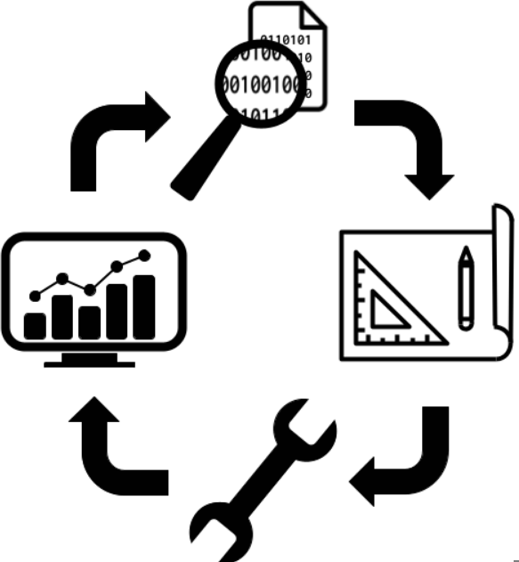
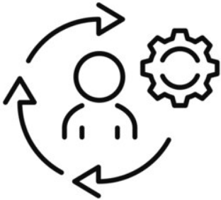
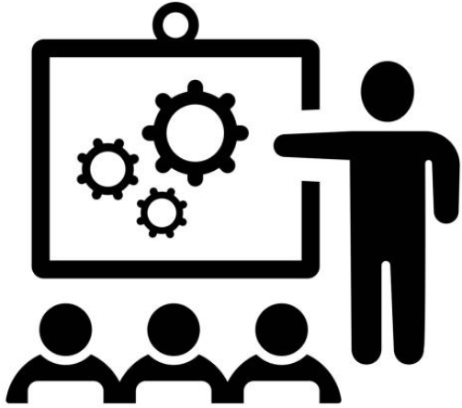
Quality Programs Summary
Organizational Alignment & Oversight
Security & Risk Processes
Steering Committee and Executive Sponsorship
Aligned and engaged stakeholders
Defined Roles and Responsibilities
Collaborative
Risk Assessment
Cyber Security Measures
Access & Enablement
Policy & Procedures
Data Quality & Management
Governance
Operations
Relevant
Regular Review
Document & Collect
Validate
Review & Report
PDSA
Change Management Process
Training & Education
Request & Request
Document
Implementation
Standardized
Validate Skill Set
Teamwork & Collaboration
Consistent
Notes:
In summary, this series has reviewed what it takes to build a framework for a Data Governance Program, aspects of some of the Quality Programs out there , their similarities and differences, and how to determine the data to collect. Today we have reviewed how to continue the momentum to maintain the framework and create a robust program.
Organization Alignment and Oversight is imperative. With an executive sponsor, a strategic plan, and a multi-disciplinary steering committee with defined roles and responsibilities, goals can be selected and the plans collaboratively made on how to reach those goals and then communicated to the larger teams.
Policies and procedures in place, not only for how the Data Governance Program conducts works, but how the organization operates as a whole are necessary evils to keep everyone aligned, consistent in their responsibilities, and provides the story of how the organization works. Maintaining that written history, if you will, helps to see where you were, where you are, and helps to move to where you want to be. Policies and Procedures are the heart of the organization, as well as the program, so make sure that what is written is truly the reality. What you do and what is written should be same story. I know no one wants to hear this, however, in legal proceedings and audits, what is written is what matters so make sure your policies and procedures are relevant to your current state, and you have a document logging any revisions with dates of those revisions.
A robust change management process is imperative to keep the program moving with agility in this ever-changing industry it is important to manage changes quickly, carefully, and collaboratively for the best outcomes. A process for requesting a change, processing the change, and implementing the change needs to be detailed, standardized, and communicated to the whole organization.
Security & Risk needs to be the forefront in all things data, which means basically the entire organization. Keeping the data safe from the outside yet being able to electronically access and exchange data is imperative to clinical care and coordination. Have a plan, review it often and perform the necessary tasks to stay compliant with regulations and safeguard the organization.
Data Quality and Management is the meat of the program where the data is documented, collected, validated, audited, and reviewed to make sure that forward momentum towards measure achievement is happening. Changes to the processes should be documented, communicated, and a training plan put into place to ensure that relevant change are made.
Ongoing Training and Education should be standardized, consistent, and promote teamwork and collaboration. Every process should have a component of education and training which also includes training from front line staff to the steering committee to education them on the processes both current and the ‘what could be’ future state. It’s this circle of collaboration and active listening that can inspire people to get involved to help move the organization forward.

Slide 16
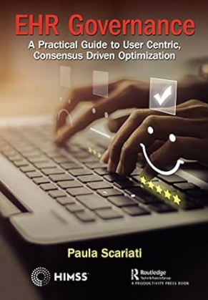
Quality Programs References & Resources
CHCANYS Data Security
https://www.chcanys.org/chc-resources/clinical-technology-resources/health-it/data-security
NCQA - Measures
https://www.ncqa.org/programs/health-care-providers-practices/patient-centered-medical-home-pcmh/pcmh-standardized-measurement/
HealthIT.gov
https://www.healthit.gov/topic/privacy-security-and-hipaa/security-risk-assessment-tool
Healthcare & Public Health Sector Coordinating Council
https://healthsectorcouncil.org/wp-content/uploads/2018/12/tech-vol1-508.pdf
National Coordinator for Critical Infrastructure Security and Resilience
https://www.cisa.gov/cross-sector-cybersecurity-performance-goals
Assistant Secretary for Technology Policy/Office of the National Coordinator for Health IT
https://www.healthit.gov/
PCI Security Standards Council
https://www.pcisecuritystandards.org/
Medicare Learning Network
https://www.cms.gov/outreach-and-education/medicare-learning-network-mln/mlnproducts/downloads/hipaaprivacyandsecurity.pdf
National Society of Leadership and Success
https://www.nsls.org/goal-setting-techniques
AAPC
https://www.aapc.com/resources/what-is-medical-auditing
Federal Tort Claims Act
https://bphc.hrsa.gov/compliance/ftca/site-visit-protocol
HRSA Operational Site Visit
https://bphc.hrsa.gov/compliance/compliance-manual
Notes:
I encourage all of you to read the book EHR Governance, a Practical Guide to User Centric Consensus Driven Optimization, by Paula Scariati. While it is geared towards creating an EHR governance program it can very well be used to create that same type of framework for a data governance program as all the same elements we have reviewed are discussed. I have lived the experiences that she details in this book and the first hand account of what went well and what went not so well. I think it will help in the journey to creating a robust program for your organization.
There are also several references here on some components to help get started on implementing your program or enhance the program you currently have. I hope you find them useful resources. It is also important to stay abreast of industry changes by subscribing to the various list serves out there. CMS.gov has a bunch and I’m sure that these sites may have them as well and can be typically found towards the bottom of the sites. I haven’t looked for them on each of these references but I do subscribe to Medicare Learning Network and some CMS ones that I find particularly helpful to stay on top of changes and other happenings in the industry

Slide 17
Q & A
Jackie Simik, B.S., CPC-A
www.linkedin.com/in/jacquelinesimik/
Notes:
We have covered a lot and now it is time to look to the chat or to hear from you. I’m curious to hear any questions or comments that came to mind
Thank you all for allowing me to share this time with you. I hope you found it useful and it will help you on your data governance journey.

Slide 18


Questions?

Slide 19



Please fill out our survey!
Please share your feedback using the survey link in the chat, the QR code, or the link in the follow up email!
Completing the survey helps us to provide relevant and helpful information. Thank you in advance!

Slide 20


