Slide 1
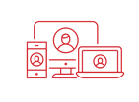
CHCANYS NYS-HCCN presents
Data Governance Excellence Series: Building a Strong Foundation
Session 1: Exploring & Implementing a Data Governance Framework
October 1, 2024
For more information, please email Anita Li at ali@CHCANYS.org

Slide 2
Housekeeping
You have been muted upon entry. Please respect our presenters and stay on mute if you are not speaking.
Please share your questions in the chat. CHCANYS staff will raise your questions to our speakers and follow up as needed if there are unanswered questions.
The webinar is being recorded and will be shared after the session along with the slide deck.
A webinar evaluation will be shared with participants

Slide 3
New York State HCCN Objectives
Project Period 2022-2025
2022-2025 Project Period
1
Clinical Quality
Patient Engagement
Patient Privacy & Cybersecurity
Social Risk Factor Intervention
Disaggregated Patient-level Data (UDS+)
2
Interoperable Data Exchange & Integration
Patient-Centered Care
Data Utilization
Leveraging Digital Health Tools
Health IT Usability & Adoption
Health Equity and REaL Data Collection*
Improving Digital Health Tools- Closed Loop Referrals*
3
Provider and Staff Wellbeing
* - Applicant Choice Objective
Bold- Objective Carried over into 2022-2025

Slide 4
Schedule of Events
Session 1 (10/1)
Session 2 (10/15)
Data Governance Program Maintenance & Strategies
Exploring & Implementing a Data Governance Framework
An Introduction to Quality Programs
Session 3 (10/29)

Slide 5
Meet the Presenter
Jackie Simik, B.S., CPC-A MANAGER, EHR ENTERPRISE APPLICATIONS Pivot Point Consulting

Slide 6
Data Governance Excellence Series: Part I Exploring & Implementing a Data Governance Framework
Notes:
Thank you for joining us today in the first of a 3-part series on Developing a Data Governance Framework
Today we will be going over what is needed to develop a data governance framework for your organization and what is involved in the process.
All participants will be placed on mute during the presentation. Please put any questions or comments in the chat so we can review them during the Q & A session. This meeting is being recorded and the slide deck will be sent out to participants at the conclusion of the session today.

Slide 7
Data Governance Presenter
Bachelor of Science in Organizational Leadership, Pennsylvania State University
Certified in EpicCare Ambulatory & Epic PB Resolute
AAPC Certified Professional Coder
eClinicalWorks® Super User and Implementation Specialist, 15 years
Multi-faceted experience spanning over 30 years in the healthcare industry:
Operations and administration
Outpatient clinics
Physician clinics
Hospital ancillary services
Revenue Cycle Management
Clinical Quality Program Initiatives
Human Resources & Employee Relations
Regulatory & Compliance
EHR Implementation and Optimization
Project Management
Jackie Simik, B.S., CPC-A
Healthcare EHR/Advisory Manager
Pivot Point Consulting, A Vaco Company
Notes:
My name is Jackie Simik and I’m a healthcare IT consultant. I have worked in the healthcare industry for over 30 years in various aspects such as Billing and Revenue Cycle Management, Oncology, Radiology, Outpatient Clinic Administration and Management, Private Practice Administration, and most recently I worked with a clinically integrated network in the Chicagoland area before coming to Pivot Point for consulting. I have a wide-ranging background that includes billing and coding, as well as regulatory compliance and data reporting.
I have been with Pivot Point for over 2 years working with eClinicalWorks customers to optimize how they utilize the various tools in their EHR to not only streamline workflows but also to help with data collection efforts. I also have 2 Epic certifications and am currently working on my Project Management Professional Certification.
Thank you for having me here today.

Slide 8
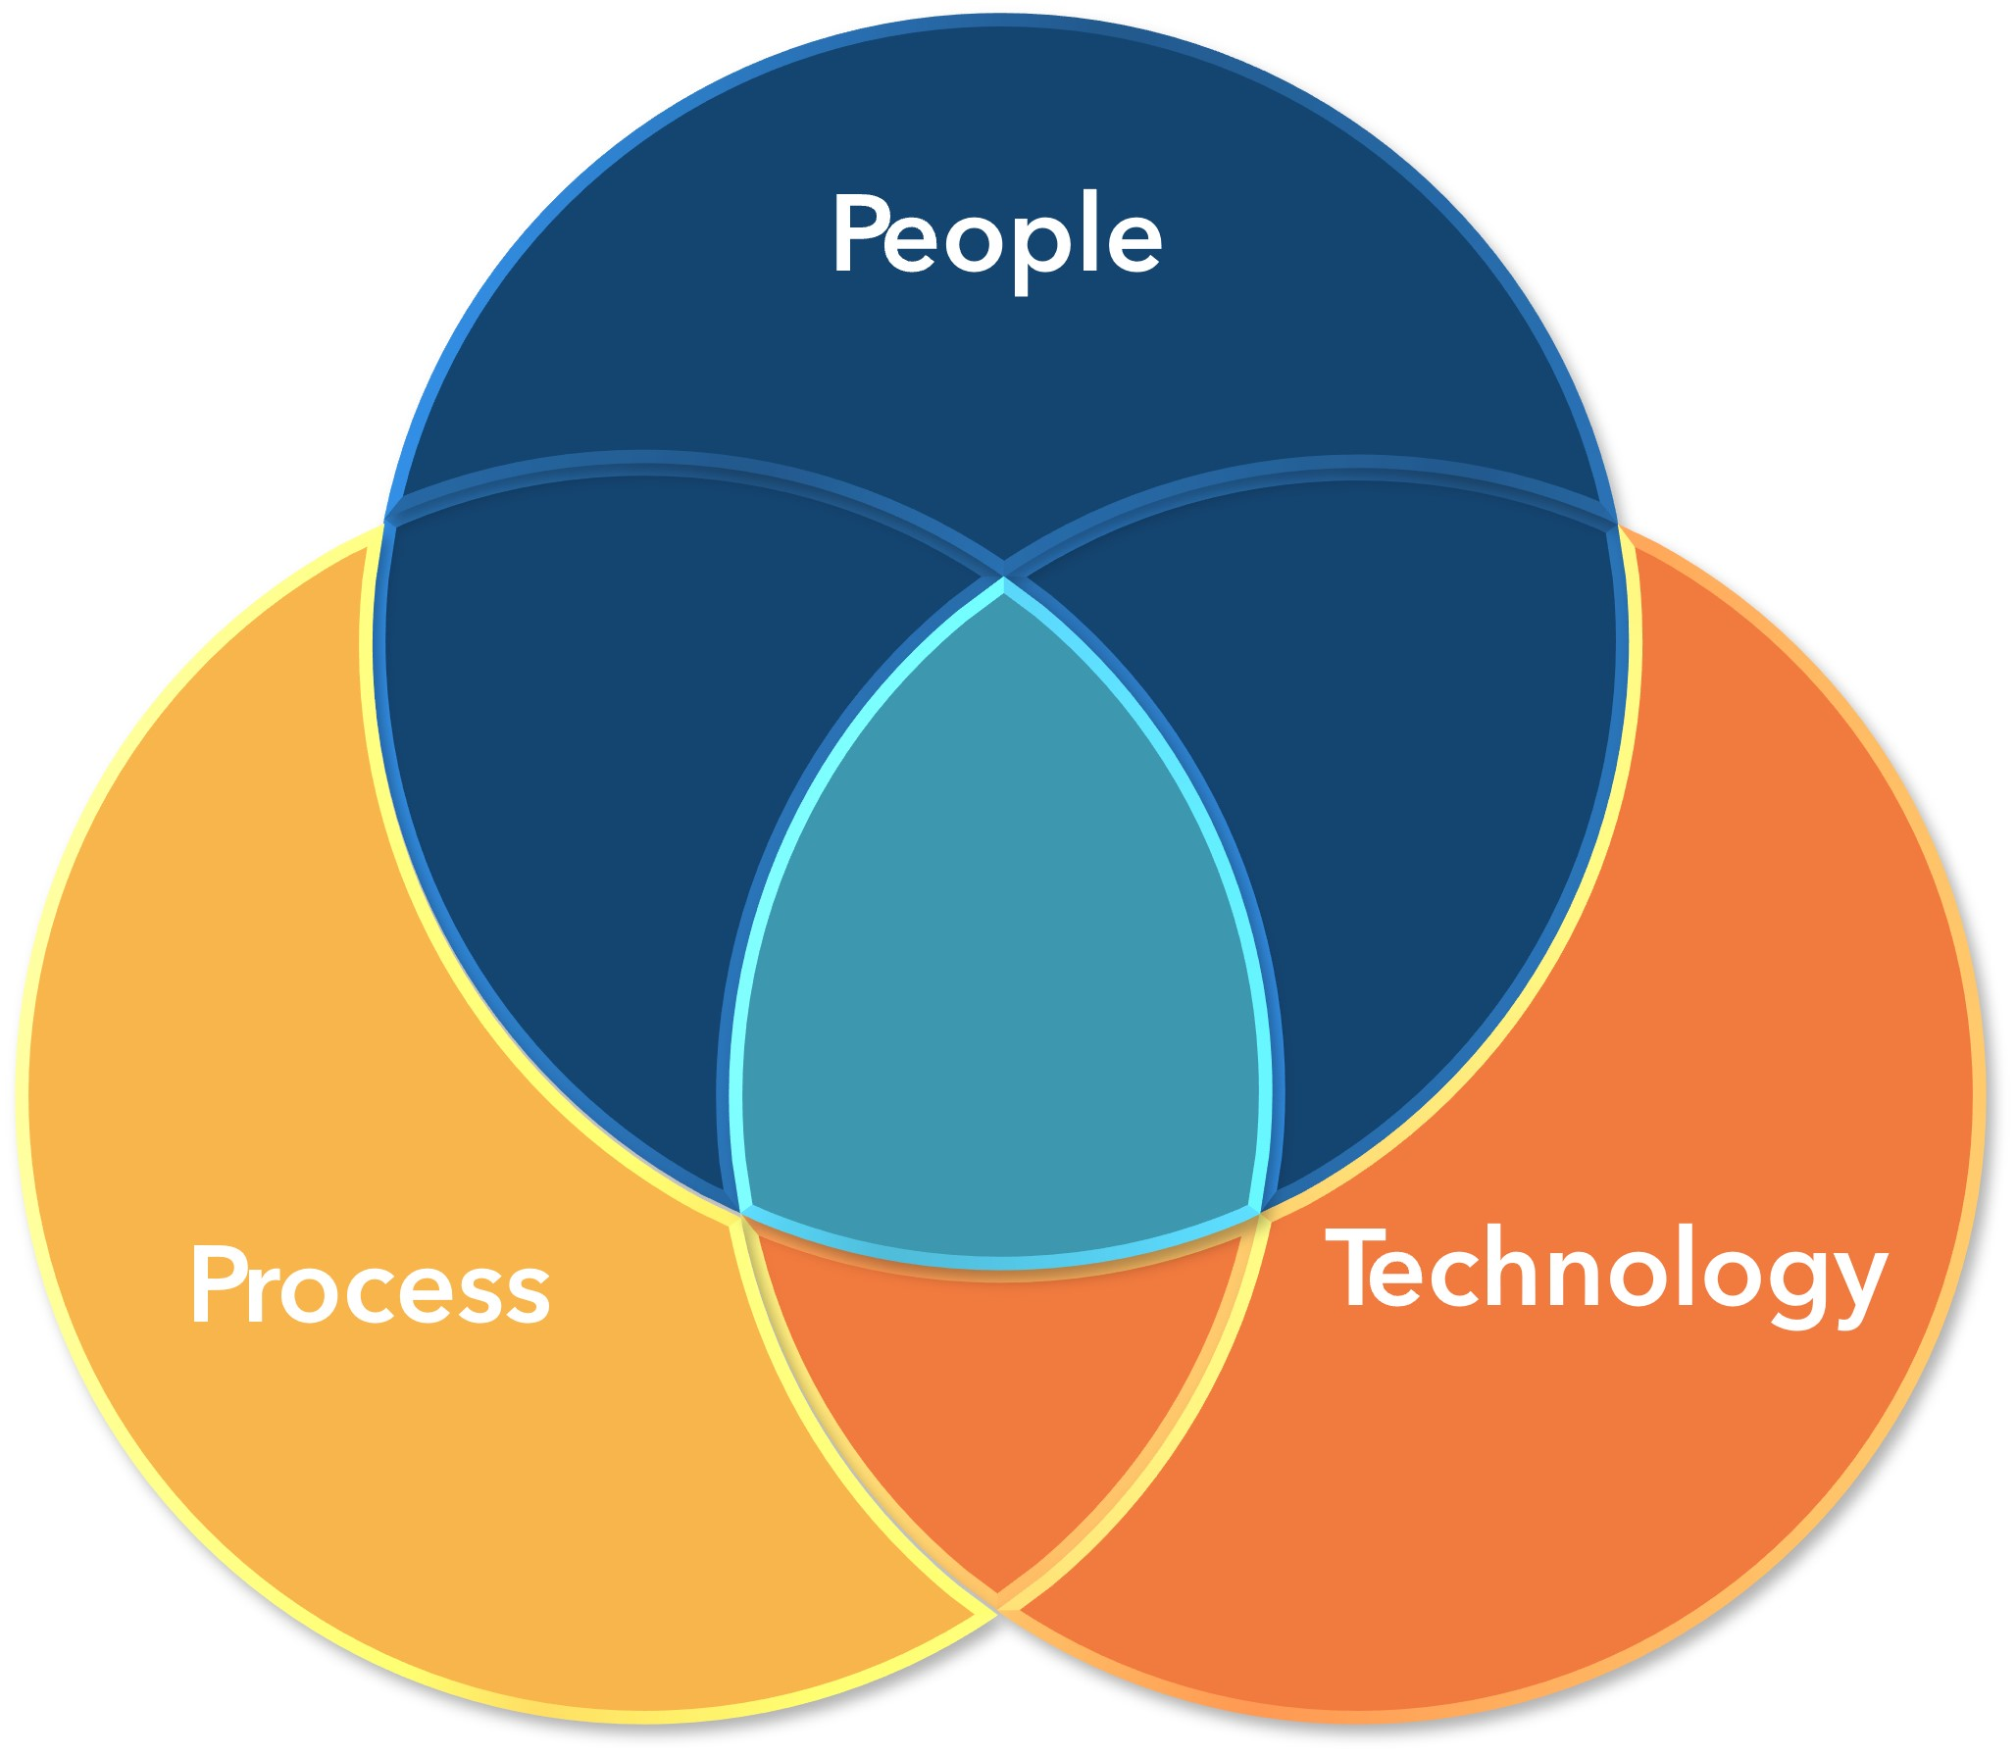
Data Governance An Overview
Data governance is a model that establishes authority and management and decision-making parameters related to the data produced or managed by the enterprise
Goals, Strategies, Alignment
Roles & Responsibilities
Policies & Procedures
Governance
Security & Accessibility
Data Access
Data Security & Risk Remediation
Data Preservation
Stakeholder Engagement
Programs Management
Data Auditing
Data Quality & Management
Data Validation
Data Cleanliness
Change Management
Notes:
The National Institute of Standards and Technology define data governance as a model that establishes authority and management, and decision-making parameters related to the data produced or managed by the enterprise.
- National institute of Standards and Technology (https://csrc.nist.gov/glossary/term/data_governance)
The primary goals of this type of program is to establish policies, standards, and practices that guide how data is collected, stored, processed, and used, while ensuring compliance with relevant regulations and quality programs. A simplified way to think about data governance is that it is about 3 main things: People, Process, and Technology
As you can see from the diagram, all of those ideas, or themes, overlap to create this synergistic program that takes into consideration all aspects of the organization, how it collects and uses the data, who has access to what, and the maintenance of securing that data, both in real time and a future state. There cannot be one without the other two in any scenario when it comes to data.
As a part of this governance, some common pieces of the framework are policies, rules, regulations, requirements, processes, organizational structure and technologies. The Framework sets clear rules relating to the roles of individuals with access or who are responsible for the data. These rules must be agreed upon across different departments of the organization to ensure the accuracy, consistency, and security of data within an organization. Its primary goal is to maintain high-quality data that is secure and accessible, enabling informed decision-making and providing valuable business insights.
This model of a data governance program is scalable to allow for growth of the organization. No matter how big or small your organization is, the framework is the same.
Let’s dig into the organizational alignment aspect and what that looks like and the things that need to be thought of and addressed when setting up a governance program.

Slide 9
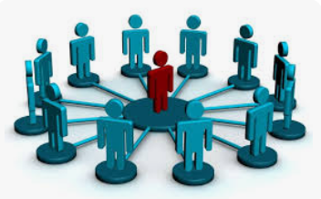
Data Governance Roles & Responsibilities
Roles & Responsibilities
Executive Sponsor
Data Governance Steering Committee
IT & Security Team
Data Producers
Data Stewards
Executive Sponsor
Risk & Compliance Team
IT & Security
Data Producers
Data Stewards
Hierarchical Structure
Matrix Structure
Executive Sponsor
Risk & Compliance Team
IT & Security
Data Producers
Data Stewards
Notes:
POLL
A data governance program needs to have roles and responsibilities for the various areas of the program such as executive sponsorship and oversight all the way down to how the data is stored and/or archived. This can be done as a traditional organizational chart or a matrixed environment it just depends on the organization and how the program will be managed. Many of you may already have some type of data governance in place and these are just a few examples.
An executive sponsor should be chosen. This should be done by role, not necessarily a person because as we know, people come and go and transition in and out of different roles within an organization as well. The roles need to be defined by title, such as Security & Compliance Officer, Director of Quality, Chief Data Officer or any title that holds some accountability for final decision making as this will be the last approval that is needed for any decisions that need to be made to move forward on initiatives. This role will provide organizational strategy guidance and disseminate goals to the team to help focus the group on what the desired outcomes are to meet the goals and strategies of the organization
Next a Data Governance Steering committee can be identified. This team includes Risk management, Regulatory Compliance, as well as those positions that hold lead roles in the different areas or departments, such as clinical leads, administrative leaders, and don’t forget the billing manager. It’s important that all areas are accounted for on this team as each of the roles have different perspectives that information may need to be viewed from and that data collection efforts may affect. Keep in mind also that the members of this team don’t necessarily need to be the managers or leads for the area being represented, but the role will need some decision-making power or authority to potentially change workflows or how data is collected so it does help to keep that in leadership. The members of this team should know the organization, the processes and procedures very well.
The IT & Security team may only be one or two people, however, this position is very important. This role will understand the complexities of the network set up, end user access policies, technical aspects of technology such as how different systems and software works and how any interfaces work for clinical workflows and data reporting. This role is also responsible for updates, upgrades, data storage and archiving, and maintenance of the technological side of the organization. They should understand how the technology works together and how any changes or needs for data reporting may impact that area. This role is also very important for Change Management processes to make sure that any implications of any changes will not have adverse affects on the overall security of the organizational data. If your organization utilizes a 3rd party vendor for IT technical support, there should be at one representative that either attends meetings or is the point person for that 3rd party for any follow up items regarding networks, devices, interfaces and other IT hardware and networking items.
Data Producers, or Custodians, are those that know the workflows and how the current processes are at the patient care or ground level. These are the people that are gathering and entering the data, such as providers, front office, medical records, nurses, medical assistants, basically anyone who touches and enters or updates anything in the current systems. They know the when, the how, and the why. Often times these are super users of a particular software system, or team leads in their area where they are the ‘go to’ person for the rest of the front-line teams. Their insights are of great importance because they bring the reality of how things really are working not just how they are on paper. This role is crucial in getting out what is put in. They are the ones that often bring up the ‘what if’s’ or the various scenarios that need to be addressed on a topic to be thorough.
Data Stewards are the collectors of the data. They run and analyze the data using reports or other tools to verify the accuracy and measurements of the data collected, identify trends in the data, and look for ways to improve either data collection or other processes to increase achievement. This role understands process improvement and how to communicate what the data means to the rest of the group. In some cases, the data steward and producer are the same person.
Now you are probably looking at this and thinking, this is a lot of people. It doesn’t have to be. Multiple roles can be assumed by one team member, especially when you are a small organization or don’t have a lot of support staff, one Medical Assistant or RN fill the role of data producer and data steward, or a physician can also serve as a data producer and maybe even the executive sponsor. This is an opportunity to get more of the front-line teams involved in the data collection and the decision-making processes that go on within an organization. In many organizations, it seems that there is only one or two people who are involved in everything, which is great, but it’s important to keep in mind that there may be some hidden talent amongst your larger teams and finding ways to uncover that is to get people involved. Selecting front line staff to delegate some tasks to and work alongside on data collection and trending can be helpful to build buy in with the larger teams and create opportunities for professional growth for individuals while also internally creating a succession plan for the future.
It is important, however, to have job descriptions for each one of these roles so it is clear as to what the role is and what the expectations are. Those team members that are selected should be aware of what their role, or job description, they have on the Steering Committee so there is an understanding of what they are accountable for within the data governance program. This job description does not have to be a separate formal job description but written into the Charter where the role is explained in detail as to what is required
With a structure in place and the roles defined now we need to determine the policies that will govern this team and how data is dealt with, which includes a change management procedure.

Slide 10
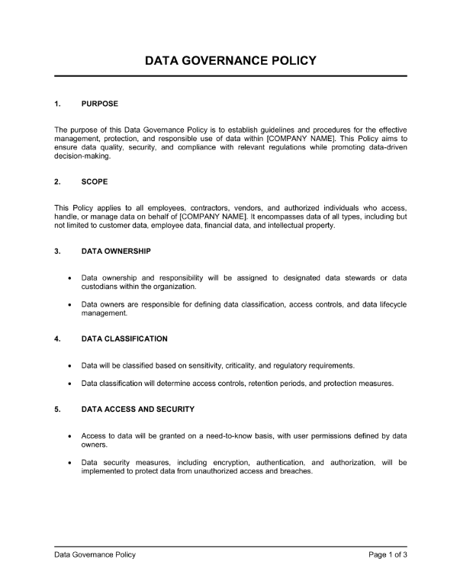
Data Governance Policy & Procedure
Data governance policy outlines the rules of engagement with data, overseeing how you access data assets and what operations you carry out on those assets
Policies & Procedures
Establish a Charter or Guidelines
Purpose / Scope
Definitions / Acronyms / Glossary of Terms
Responsible Stakeholders
Exemptions
Related Policies and References
Change Management
What change is needed and why
Risks vs. Benefits
Who does the change impact
Are there any regulatory requirements impacted
Notes:
It is important that each member of the data governance program understands the core objective, protocols and success measures of the program, who has the right to make which type of decisions, and the group processes for reaching decisions around data.
The first phase is about establishing the Mission, Goals, and responsibilities and procedural approach typically through a document called a charter or guidelines. Taking the time to define the purpose and working methodology of the Data Governance program will put the organization in a solid position moving forward, especially with challenges associated with change management. It will be the reference in which all projects and issues are guided by. Take the time to create this document for consistency and standardization of the process. It’s the who, what, when, and why of the program and how it is to be run.
Most policies and procedures can be drawn up as needed however, the most important policy that is nearly a requirement, is the Change Management Policy and Procedure. In this collaborative governance framework, there needs to be a way for the changes to be managed so everyone is informed as to what needs to be changed, why, and how it will impact the other areas. Sometimes this may be a minor change, other times, it may negatively affect other areas which will require the need for additional discussion and perhaps workflow changes. When those happen there are things that need to be discussed such as timing of the change, whether or not end user training is required, maybe new hardware is needed to support the change, so many things could be involved so a robust change management process is a must.
Ask the questions,
What change do you want to make
How does it benefit the organization and/or individual team(s)
How does it affect productivity
What is the impact to the existing business process
Is there a legal or standard certification requirement
How will the changes be tracked and what documents will need to be updated or created if the change is implemented, policies? Procedures? Job descriptions?
This is also why it is important to make sure that all policies, procedures, and job descriptions are reviewed at least annually to make sure that they are current and relevant to the workflows and tasks that are being done. This is especially important if there is an audit on the organization by a regulatory agency. Policies, procedures, job descriptions, and security and risk assessments are almost always the first things that are requested in audits. The goal is to make sure that what is being done is what the policy or procedure states will be done. I cannot stress this enough and it is often a commonly overlooked item for the sheer fact that this is a very time-consuming task in a very busy and eve- changing industry such as healthcare.

Slide 11
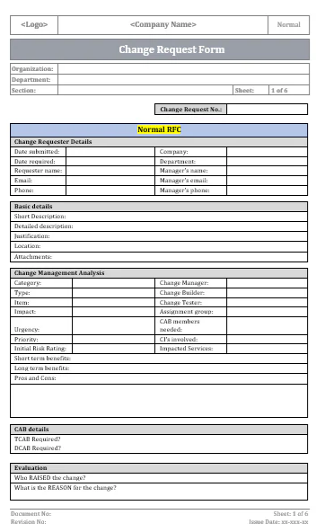
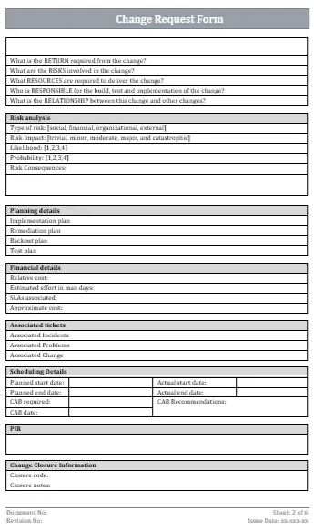
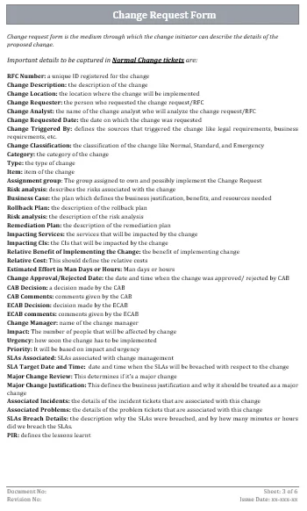
Data Governance Change Management
https://www.itgov-cos.com/products/change-request-form
Notes:
POLL
This is an example of one type of change request form. It is lengthy but this would be something that your steering committee would need to put together so the changes can be requested and all the items that need to be known are on here so the team can make an informed decision. Notice that this does have a glossary of terms, which is super helpful for those completing one of these especially since this can be used by anyone in the organization to request a change, so it needs to be clear. Maybe this change request form is way too much for your organization, and you may decide to use a simpler form, that’s okay. The important part is that it is documented. At the very minimum, you need to know who is requesting the change, when was it requested, and why is it being requested.
Some change requests, when reviewed, will require the person who requested the change to attend the meeting to provide more information. Some change requests can be ranked in importance, priority, or impact to an area. This is all up to your organization to determine and put in your Change Management Policy and Procedure.
Now the team is assembled, we have governance established, and a change management process created, the work can really begin. The Steering committee needs to review the organizational strategy and goals to see how the Data Governance can play a part in achieving and fulfilling the strategic goals.

Slide 12
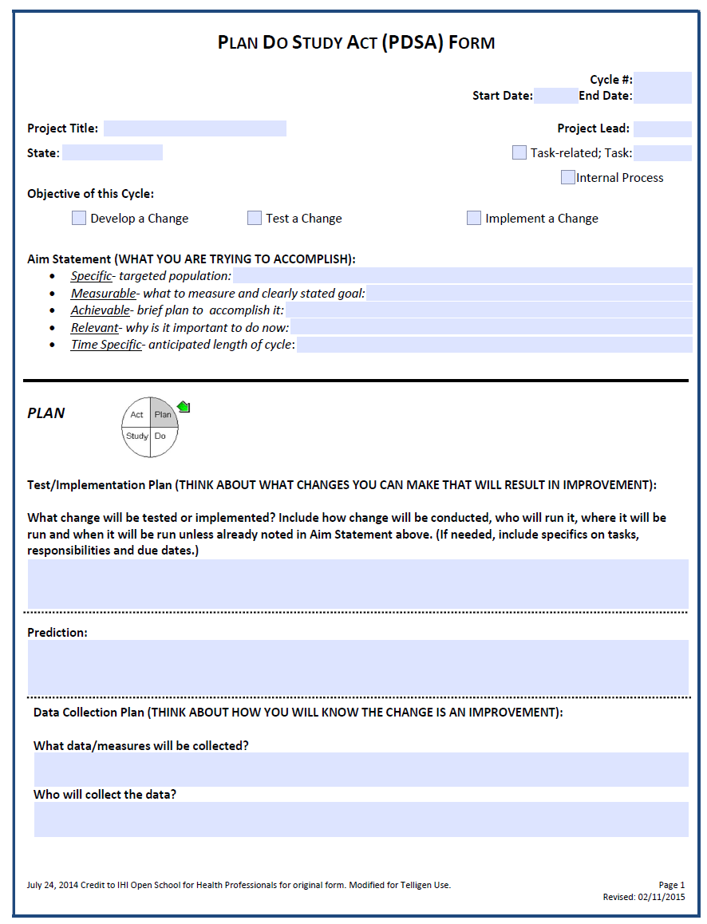
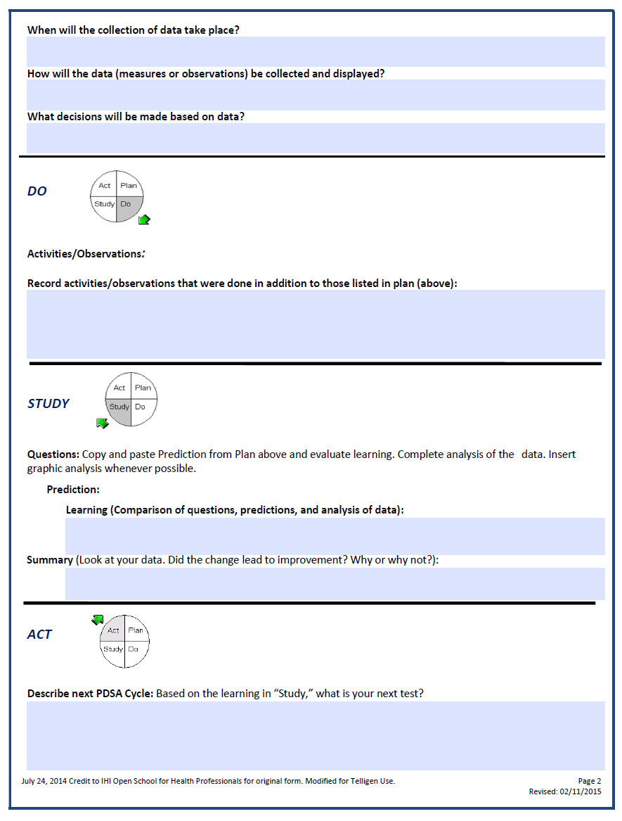
Data Governance Organizational Alignment
Strategy
What is the strategic plan of the organization?
What is the mission?
What are the values?
What are the requirements or regulations the organization needs to follow?
What do you want to improve, internally or with the patient population?
Goals
Roll up to the strategic plan
Know the why behind the goal
Determine how each area can contribute to the goal
How will the goal be measured?
How will you know the goal has been met?
What will the data be used for?
How will the data be validated/audited?
Notes:
Communication of the organizational strategic plan is so important. Where are we now and where do we want to go? What are the values of the organization? What is the mission of the organization? What is the 5-year strategic plan and how does data collection fit into meeting that strategic plan? Are there requirements or regulations that need to be met for funding or other reasons? What data is being collected now? What data needs to be collected? What are you going to do with the data that is collected? We don’t want to collect data just to collect it, we want to use it, so what about your patient population do you want to improve upon? And remember, data collection is not just about your patient population either. A data governance program also includes internal organizational goals that may need to be met so they, too , need to be included in the data governance framework being built.
With a strategic plan in place and communicated, goal-setting is next. You want your goals to be set in such a way that they meet the strategic objectives, this seems obvious but sometimes goals are created with a good intention but fall short of the objective they were originally meant for so being very thoughtful on what needs to be achieved can take some planning and discussion. It’s important for everyone involved to know the ‘why’ behind the goal. By creating goals that have a connection to the strategic plan those involved in meeting those goals have a clear reason why they are documenting and collecting the data. This helps everyone understand what their contribution is to the final outcome. Create SMART goals: Specific, Measurable, Achievable, Relevant, and time-bound. It’s important that the goal is measurable, useful, achievable …. Even if these means to create ‘stretch’ goals or minimum/maximum milestones, and that the goals don’t go on forever. They need to be achievable so as to complete that goal to move to the next and build upon them. Document what data needs to be collected, by whom, who is responsible for collecting it or the workflows that are connected to that goal. This can mean that several different areas are involved, again, collaboration and communication between different disciplines is very important to stay on track. The last and most important step is to make sure that the data can be validated to ensure its accuracy and collected in a standard way, meaning collecting the data should be done with a consistent, standard process, and any deviations from that standard are documented and taken into consideration during the analysis.
In short, the goal should connect to, or roll up to, the organizational strategic plan, have assigned accountability, be specific, measurable, and have an end date or some way to account for the progress towards the goal, such as a monthly dashboard or regular intervals of audits to evaluate where the goal is in terms of being met. This information should be reviewed in a timely fashion, trends identified, and in included in the overall Process Improvement Plan for the organization. Using the PDSA, Plan Do Study Act methodology can be a helpful way to continually keep an eye on progress or changes that need to be made. It’s a great way to document the story of the initiative and lessons learned for future initiatives. It may be a good idea to have a PDSA for every initiative in your Process Improvement Plan for record-keeping and tracking progress.
Now that goals have been established Data Quality and Management is where the magic of data collection happens and it is the largest piece of the Data Governance Program

Slide 13
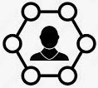
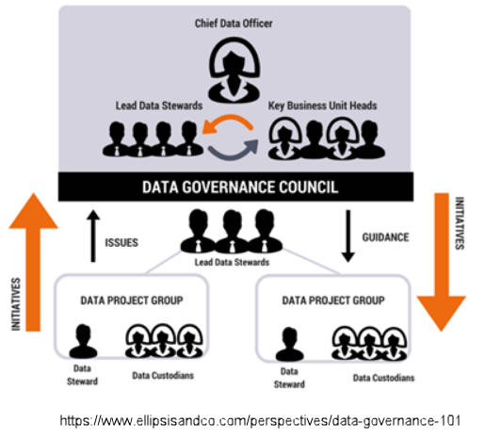
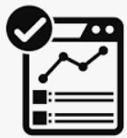
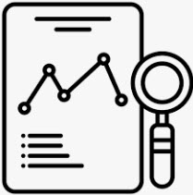
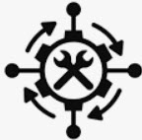
Data Governance Data Quality & Management
Stakeholder Engagement
Change Management
Key players that impact the ability to achieve goals
Current state vs. Future state
Two-way Communication
Communication
Collaboration
Commitment
Program Management
Initiation
Planning
Executing
Data Validation
Requirements
Relevancy
Clean data
Data Auditing
Establish key metrics and standards
Auditing tool & results reporting
Communication & Education
Data Security & Risk Remediation
Security Access Policy
Security & Risk Assessment
Ongoing Remediation Plan
Notes:
Stakeholder engagement is all about the key players that do the work, perform the tasks, input the documentation, gather the data and make sure that everyone involved is aware of the process and is provided any training. They are the ones who have the highest impact on goal achievement. It is critical to have team members that are involved, engaged, and have a team attitude and understand what they are trying to achieve. Being transparent on the reasons why things are done a certain way will allow the stakeholders to remain engaged and may even yield better ways to capture data. Collaboration and sharing of ideas is very important to maintain engagement.
Program Management is responsible for initiating the plan put forth by the Steering Committee and planning how it is to be accomplished with the key stakeholders and executing the proper workflows or steps to work towards meeting the goals. This includes the who, what, when, and how of the data collection efforts – when plans are put into place, workflow documentation and training needs must be taken into consideration so the team can be the most productive
Data Validation ensures that the requirements for the goal are being met, they remain relevant and consistent in how data is collected, and look for duplication of data, missing data, or data that is improperly formatted or documented. This is a very important piece to make sure that the data is accurate and useful as some requirements may change over time. We don’t want to collect data just to collect it, we want it to be useful and helpful to meeting the organization mission, goals, and regulatory requirements.
Data Auditing should be done either prospectively or retrospectively, or both, depending on the key metric or standard. There should be a standard auditing tool, a standard way of selecting what to audit and a schedule as to when audits will occur. Regular reporting tools such as dashboards, progress reports, or other regular report out methods should be consistent. The data contained in those audit reports needs to be analyzed to make sure that additional training or education that needs to be done or changes or tweaks to the data collection process happen in a timely manner to continue forward momentum towards the goals.
Data Security & Risk Remediation is not just an annual duty with the Security and Risk Assessment, but an ongoing maintenance task at each step of the process. For high or medium risk items a remediation plan should be created and updated regularly with the progress of mitigating those risks to keep them in the lowest category possible. All team members are responsible for ensuring the security of the data.
And finally, the Change Management Process. So important! This requires open communication, collaboration and commitment from the team and the key stakeholders to ensure that the tasks stay on track and any deviations in how things are being performed, collected, or reported are agreed upon and updated in policies and procedures. Not only is this especially helpful for training and onboarding but it also provides a history of what has happened in the organization and how things were changed, when they were changed, and the reasoning it was changed. This is one of the most underrated items and often the policies and procedures are not updated as they should be. When team members leave, these documents are an invaluable resource that will provide newcomers a history of why things are the way they are and the justification behind the workflow or data collection efforts in place.
The diagram here shows how all the pieces of the Data Governance program works. You have the Data Stewards and Data Producers, or Custodians, who make up a project group that carries out initiatives set forth by the steering committee to achieve goals. As issues arise, they look to the Steering Committee for collaboration, explanation and decision-making on how best to move forward and resolve the issues. This is Change Management. Once the guidance has been provided it moves back to the Project Group made up of the data stewards, producers, or custodians to carry out the guidance.
Everyone in the process needs to be present and involved to make certain that all perspectives have been looked at for the best possible decisions to be made and documented. The who, the what, the why, and how to move forward.

Slide 14
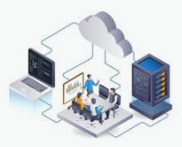
Data Governance Security & Risk
Technical IT & Hardware
Enablement & Access
Risk Remediation
Network
Hardware
Software
Installation
Maintenance
Interfaces
Data Science
Reporting
Archiving
User Access
New
Inactive
3rd Party / Vendor
End User Needs
Hardware
Software
Security Rights
Help Desk
Security & Risk Assessment
Remediation Plan
Cybersecurity
Data Sharing / Interoperability
Disaster Recovery
Mobile APPs
Remote Access
Notes:
The IT piece is a big one. It is important to have a technical IT team who is skilled in networking, hardware installation and troubleshooting, software installation, maintenance, and interfaces. The data science piece really refers to someone knowledgeable about running reports and even using some analytics tools to help decipher and slice the data for reporting and data mining. While that piece is not required, it is certainly helpful to have at least a cross-trained person who has some skills relating to using software tools to help retrieve and disseminate the data collected. It doesn’t even necessarily need to be an IT person, but someone in the organization that possesses that skill set.
Part of the Security team should also have onboarding and offboarding procedures for team members coming and going from the organization. This includes any 3rd party vendors that may need remote or on-site access, such as auditors or medical device companies. There should be a process in place that is standardized to provide and revoke access to the network and systems for end users. A matrix of which roles should have access to which programs and within those programs what type of access should that person have for the role that they have within the organization. This should be tightly monitored which is what Risk Remediation is for.
Risk Remediation is not just a once-a-year task. The remediation plan is a living breathing document that is continuously changing as the organization and industry changes. Cybersecurity is extremely important in our digital age and data sharing and interoperability is moving forward at a very fast pace. There needs to be a means to keep PHI safe and secure while providing only those that need access to perform their duties. This should also be reviewed at least annually to ensure that no information is provided to bad actors or those that should not have access. Mobile apps are very popular in healthcare EHRs and these, too, need to have some sort of security monitoring to ensure the privacy of the data.
Disaster Recovery is an all too often overlooked part of Risk, however, as we have seen in the most recent year, it really is not a matter of IF but when a disaster will happen and being prepared is always the best option. The recent cybersecurity attacks have proved to be very costly for the organizations, both large and small, that were affected. Don’t let this be your organization. Be Prepared.

Slide 15
Data Governance Building Your Framework
Roles & Responsibilities
Policy & Procedure
Strategy & Goals
Data & Quality
Security & Risk
Determine a Structure
Hierarchy
Matrix
Select a Sponsor
Executive Leader
Decision-maker
Build a Team
Steering Committee
Key Leaders
Influencers
All Areas Represented
Responsibilities
Assign Roles
Skill Set Requirements
Job Descriptions
Establish a Charter
Define Purpose
Define Processes
Glossary of Terms
Change Management
Create process
Documentation
Request
Outcome
Implementation
Documentation
Creation
Review
Standardization
History
Develop a Strategic Plan
Requirements
Regulations
Wants & Needs
Goal Setting
Specific
Measurable
Achievable
Relevant
Time-bound
Responsibilities
Documenting
Tracking
Reporting
Stakeholder Engagement
Influencers/Key Players
Collaboration
Celebrate the Wins
Management
Status Reports
Data Validation
Change Process
Auditing
Pro vs. Retrospective
Standardized Tools
Regular Intervals
Trend Analysis
Education
Technical
Network & Domain
Hardware/Software
Interfaces
Access & Enablement
Onboarding
Offboarding
3rd Party
Role vs. Security Rights
Security & Risk Assessment
Remediation Plan
Disaster Recovery
Cybersecurity
Remote Access
Training & Education
Notes:
In summary, a data governance program covers these 5 areas.
Roles and Responsibilities are how your program is structured, who is the final decision-maker, and who is the team that will be included in the collaborative discussions. Each of those roles will need a job, or role, description so each member understands their role on the governing team, or Steering Committee. I’m sure that many of you have something like this in place, but maybe not as formal. If you are just starting out, think about who you would select as your executive Sponsor and about who you may want on your governance steering committee, is a good place to start. Who are the key leaders or influencers in your organization, either formally or informally.
Creating Policies and Procedures that outline how the data governance program will function is essential to keep everyone on the same page and aligned with the organizational mission, vision and values. A robust change management process needs to be put into place to be able to tell the story of the what, the how, and the why along with the outcomes that the change produced or the future changes it leads to. This is the best way to document any changes that take place in your organization not only for communication and education to the current team, but to the future team as well. What does your change management process look like? Is there documentation of the changes anywhere? Do you already have a team that meets to discuss these? If not, what are you doing now and how is that working. Change management can look different from organization to organization but what should be consistent is the documentation of the changes; the who, when, what, and why for the change including the outcome.
Each goal set should roll up to the strategic plan whether it is to meet requirements, regulations, or to achieve the wants or needs of the organization for the patient population or for their internal teams and initiatives. Using the SMART methodology, the goals should be Specific, Measurable, Achievable, Relevant, and Time-bound and communication of the progress towards the goals should be documented and disseminated to the team, and even the team at large to keep everyone informed. This can be as simple as a place on the agenda in a team meeting or can be more formalized in a newsletter or posting the dashboards on a shared network. The important thing is to have transparency as to where the organization is tracking on the goals set. If there are no team meetings held, perhaps implement that to a Town Hall meeting where the goals of the organization are reviewed and the progress towards those goals are communicated. Determine a frequency of the meetings and stick to them.
Data and Quality includes many facets of the program such as stakeholder engagement, daily management, and auditing. Stakeholders need to be kept educated and informed of the progress. Celebrate the wins along the way no matter how small as it helps to keep the team motivated and engaged in the process. People feel good when they know they are working with purpose.
Daily management of the teams is very important. This does not mean micro-managing but having the goals in mind with everything that is being done. Looking for ways it is impacting both internal and external customers and monitoring the processes looking for both what is going well and what needs to be looked at more closely. Collaboration throughout the organization is a key to having a solid program. People need to know that every idea counts and sometimes the best ideas come from those that have more insight than leadership.
Auditing is particularly important to make sure that the results can be analyzed for any trends and education, if needed, can be done or perhaps changes in the way the documentation is collected will need to be tweaked. Standardized ways of collecting, auditing, and validating the data should be documented so it is consistent in the analysis. Be sure to know your baselines. Where are you now? Where would you like to be?
There needs to be a technical piece, whether this is through a 3rd party IT vendor, or internally, there needs to be management over the hardware and software used in the organization along with standardized, documented policies and procedures for providing access to all types of end users and applying security rights to those roles. Risk assessments and remediation plans need to be documented, reviewed, and updated on an ongoing basis as changes come swiftly in this industry.
Each of these key areas of the framework should have a training and education component where everyone is learning and collaborating and improving together. Don’t forget your onboarding processes. They need to be consistent and relevant to your current state. Try not to have all training done one-on-one, have workflows documented and reference guides available. This ensures that a standard is followed, and everyone is told the same thing. If your written procedures do not match your current state, then start there.
It may seem a bit overwhelming but I’m sure that your organizations have some of this in place, although it may not be as formalized as this. Working to make it more formalized will help organize the teams and standardize the process to streamline how your organization manages and tracks the data needed. Knowing the Who, the What, the How, and the Why helps organizations collaborate and communicate and work together to achieving their goals.

Slide 16
Q & A
Thank you
Jackie Simik, B.S., CPC-A
www.linkedin.com/in/jacquelinesimik/
Notes:
I realize that was a lot of information but I’m curious to hear any questions or comments or even some of your experiences within your own organization you’d like to share that came to mind and if there were any questions put into the chat during the presentation that we can review

Slide 17
Data Governance Resources
Health & Human Services: HPH Cybersecurity Gateway
https://hhscyber.hhs.gov/
American Health Information Management Association (AHIMA)
https://www.ahima.org
The Office of the National Coordinator for Health Information Technology
https://www.healthit.gov/playbook/ambulatory-guide/data-governance/
Centers for Disease Control
https://www.cdc.gov/healthyyouth/evaluation/pdf/brief3b.pdf
Agency for Healthcare Research and Quality
https://www.ahrq.gov/ncepcr/tools/transform-qi/deliver-facilitation/healthit-advisor-handbook.html
Centers of Excellence Resource & Advisory Support
https://resources.data.gov/
Notes:
I have listed various resources covering some of the items we discussed here today. I encourage you to take a look. HealthIT.gov is one of my ‘go-to’s there is a wealth of information along with educational pieces to help educate your teams.
Thank you all for allowing me to share this time with you. I hope you found it informative and useful. In Part 2 of our series, we will be looking at some of the quality programs, codes to know, and discuss the measures. I hope to see you there.

Slide 18
Questions?

Slide 19
Continue the Conversation
Don’t miss the next session of this 3-part series!
Session 2: Tuesday, October 15
An Introduction to Quality Programs
We hope to see you then!

Slide 20
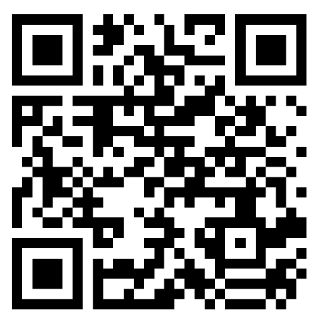
Please fill out our survey!
Please share your feedback using the survey link in the chat, the QR code, or the link in the follow up email!
Completing the survey helps us to provide relevant and helpful information. Thank you in advance!

